Slide 1
You Are Fatigued, But You Are Powerful Understanding Burnout Among Residency Coordinators
George S.M. Dyer, MD

Slide 2
Disclosures
Residency program is supported generously (labs, supplies, etc.)
Depuy Synthes
Stryker
Smith and Nephew
Biomet
I have not figured out how to get personally rich by doing education

Slide 3
My Real Disclosure

Slide 5
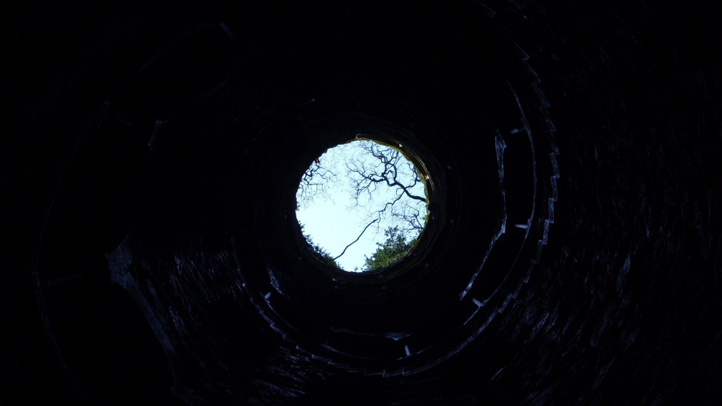

Slide 7
Jennifer Duane

Slide 8
Kaitlin Duffy

Slide 12
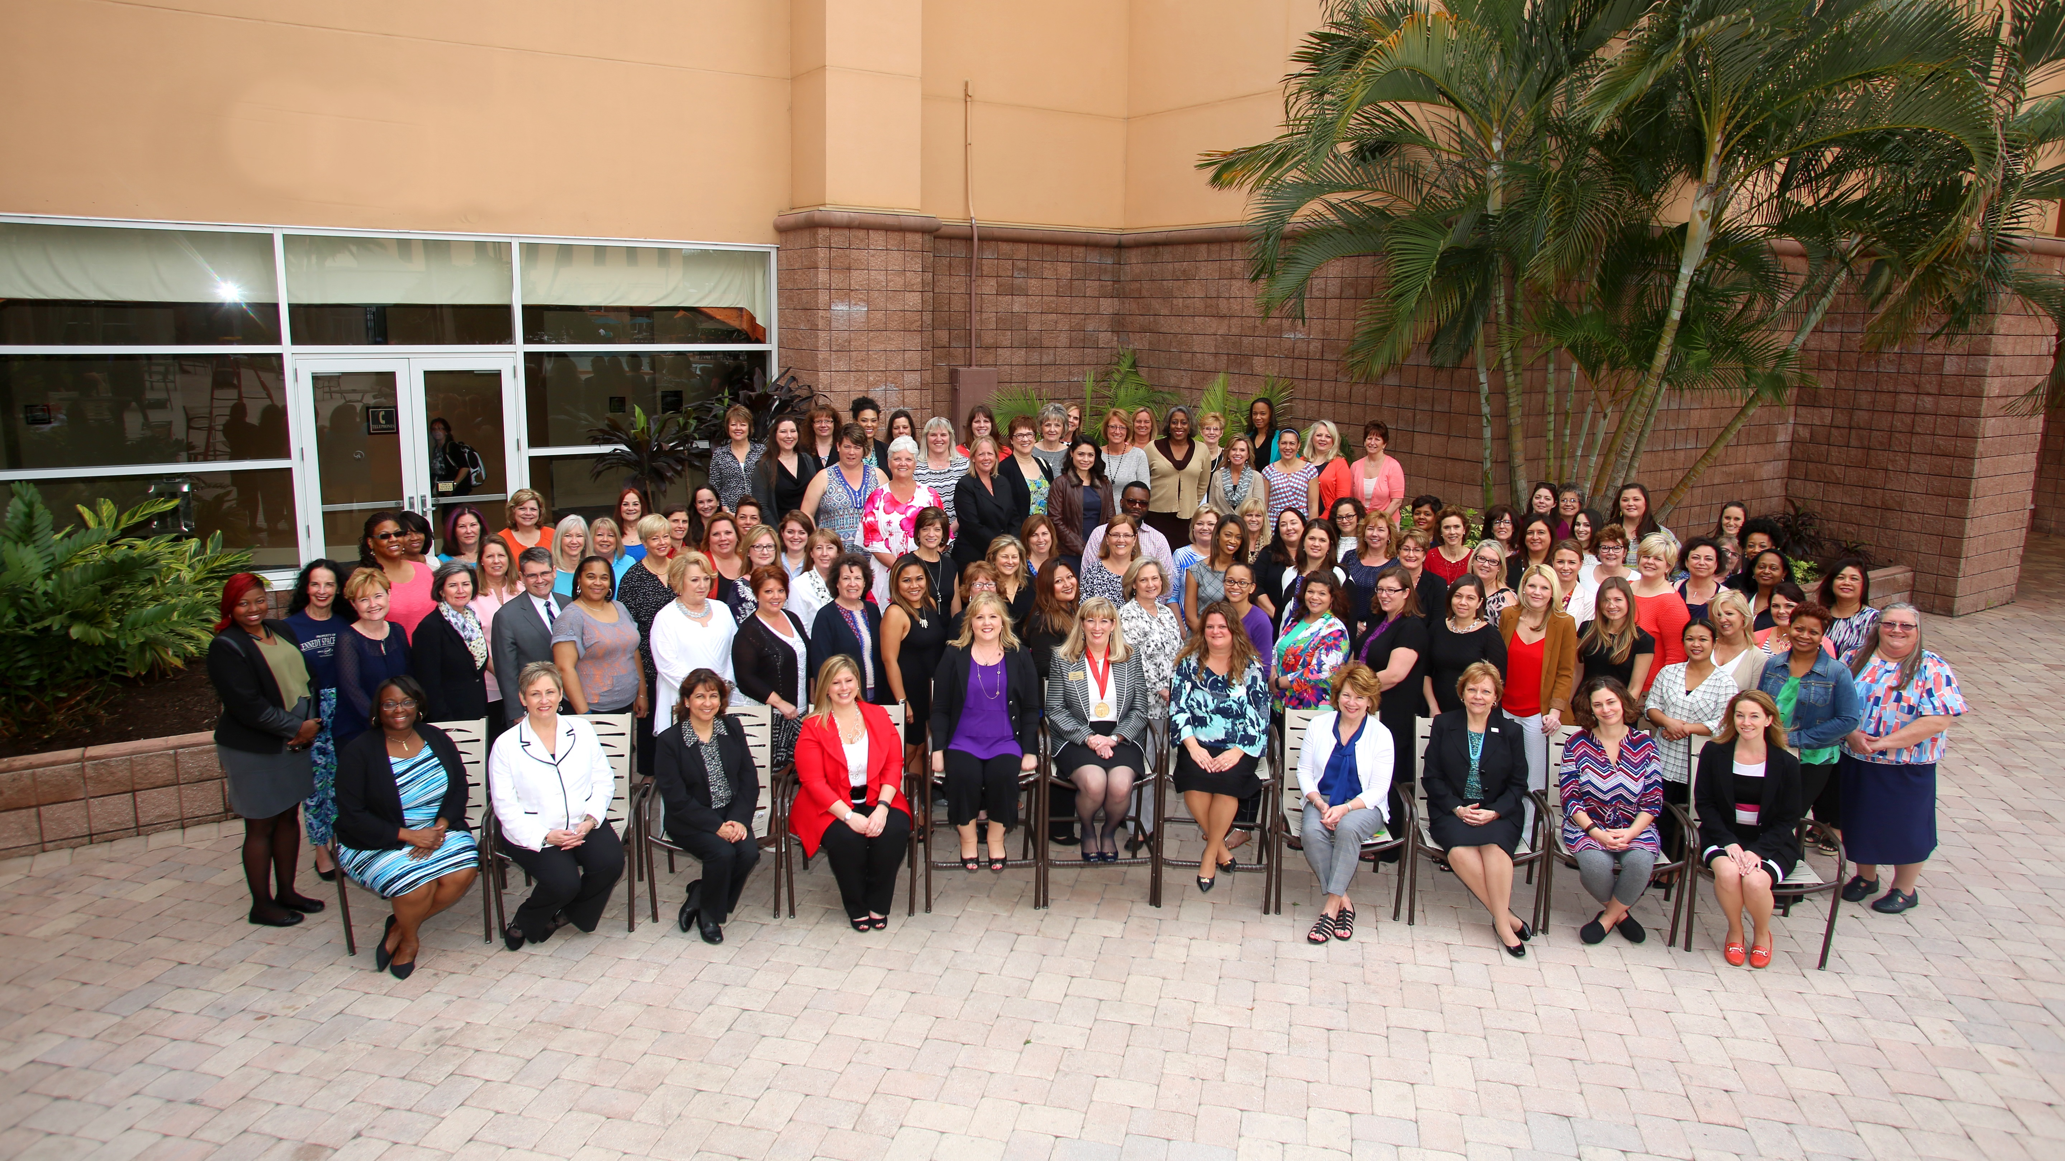

Slide 13
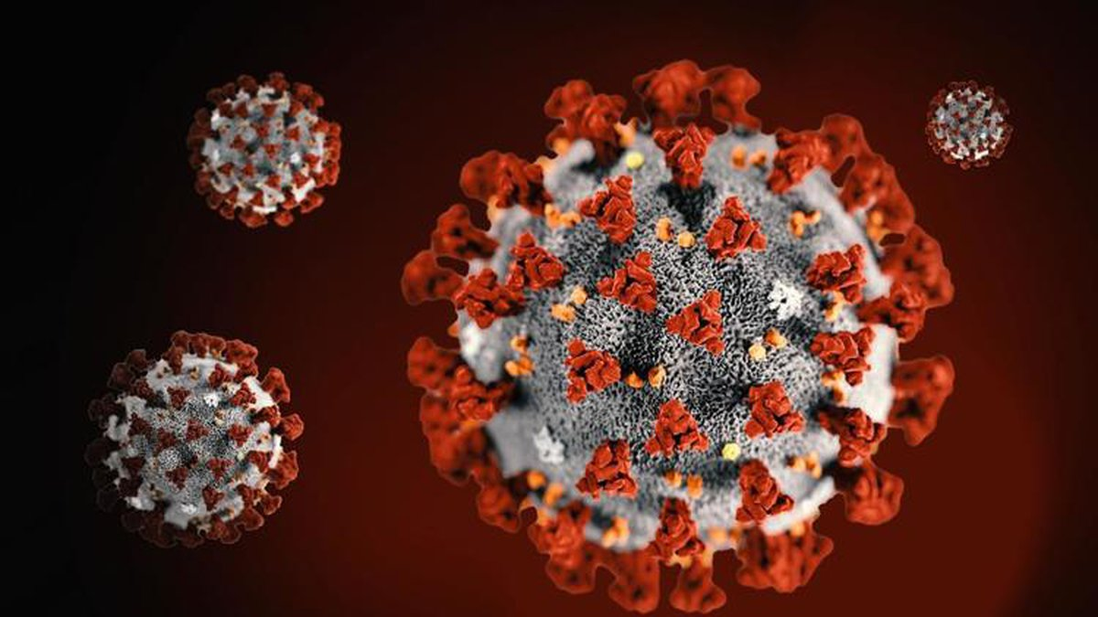

Slide 15
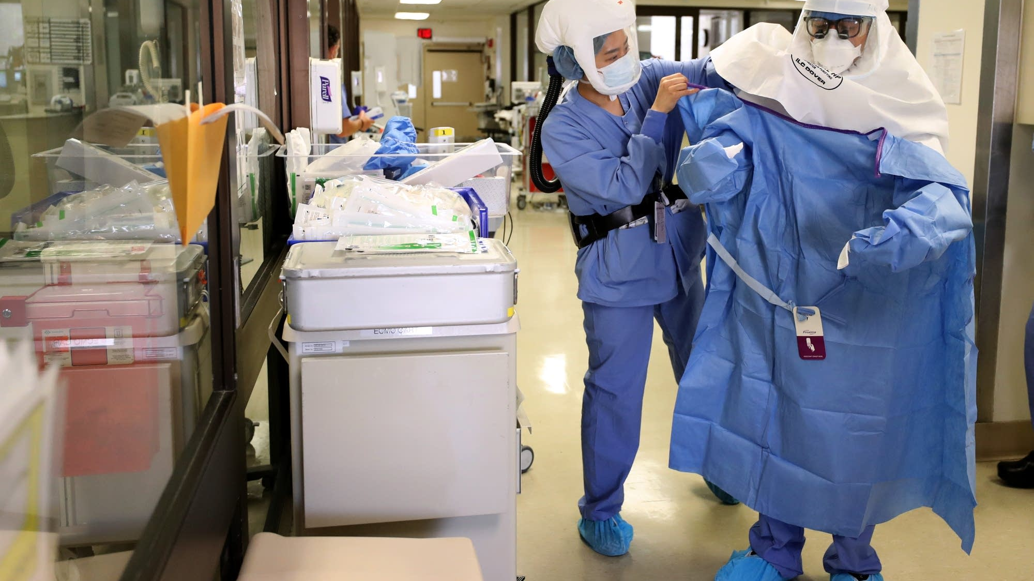

Slide 17
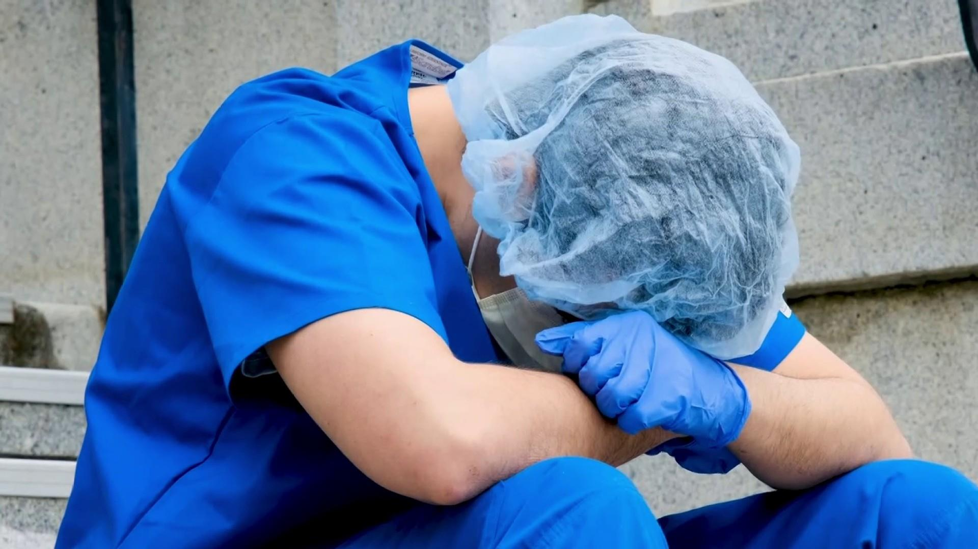

Slide 18
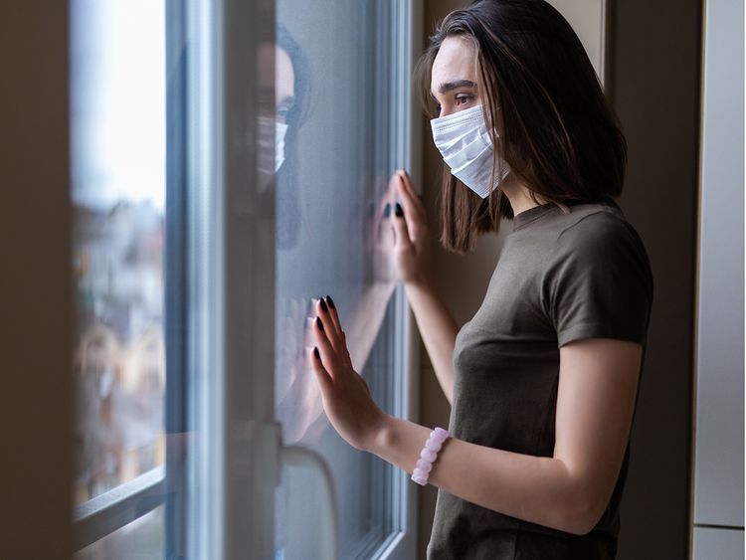

Slide 20
The Numbers
111 completed surveys—thank you!
Answered the survey
Added COMMENTS

Slide 21
Averages: A Snapshot of You!
Average Age: 47
Average Experience: 10 years

Slide 23
43 Years!

Slide 26
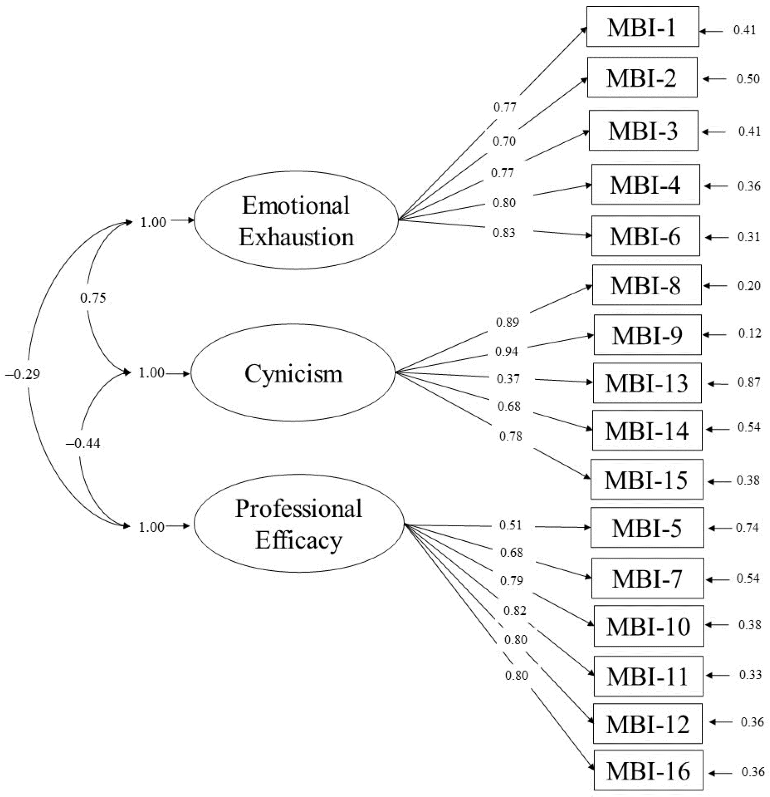

Slide 27
Scoring For Each Dimension
Never (0)
A few times a year or less (1)
Once a month or less (2)
A few times a month (3)
Once a week (4)
A few times a week (5)
Every day (6)

Slide 28
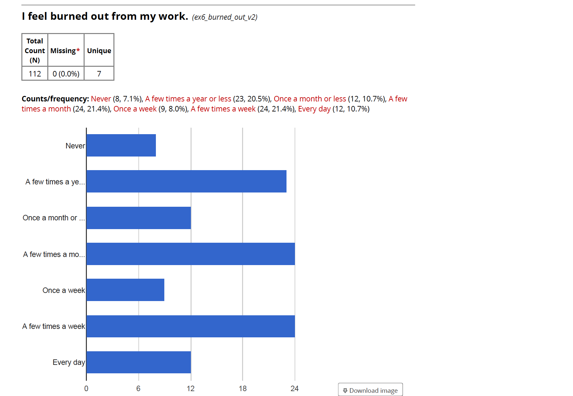

Slide 29
53% Exhausted
4% Very Exhausted

Slide 30
39% Cynical
2% Very Cynical

Slide 31
98% Effective
45% Very Effective

Slide 32
Comments
Most rewarding
Most frustrating
Other comments

Slide 34
I love, love, love my residents. They are the best. I find it rewarding any time I can reduce their stress and help them with administrative tasks that can overwhelm them.

Slide 35
Feeling disconnected from the people I work with, constantly battling bureaucratic rules, poor morale throughout the program/organization

Slide 36
Working with faculty who either refuse to complete evaluations or wait until the last minute to complete them.

Slide 37
I enjoy working with the residents and watching them progress year-to-year and through various major life events.

Slide 38
That our department is scattered all over the medical campus. If you need a faculty member, resident, or other personnel, you have to track them down. If you have to go to the GME office you know that you will be away at least an hour.

Slide 39
Relying on the responses and action of others to complete my job tasks and projects.

Slide 40
Constant, repeated reminders to the residents and faculty to complete required tasks or communicate information. Lack of engagement from faculty and residents for important events such as resident recruiting.

Slide 41
The role of the coordinator in making the residents and fellows feel welcome and that they know they can come to us is extremely important. While their clinical learning is paramount they need to be able to know who to come to in any situation and that is where the coordinator role is invaluable.

Slide 43
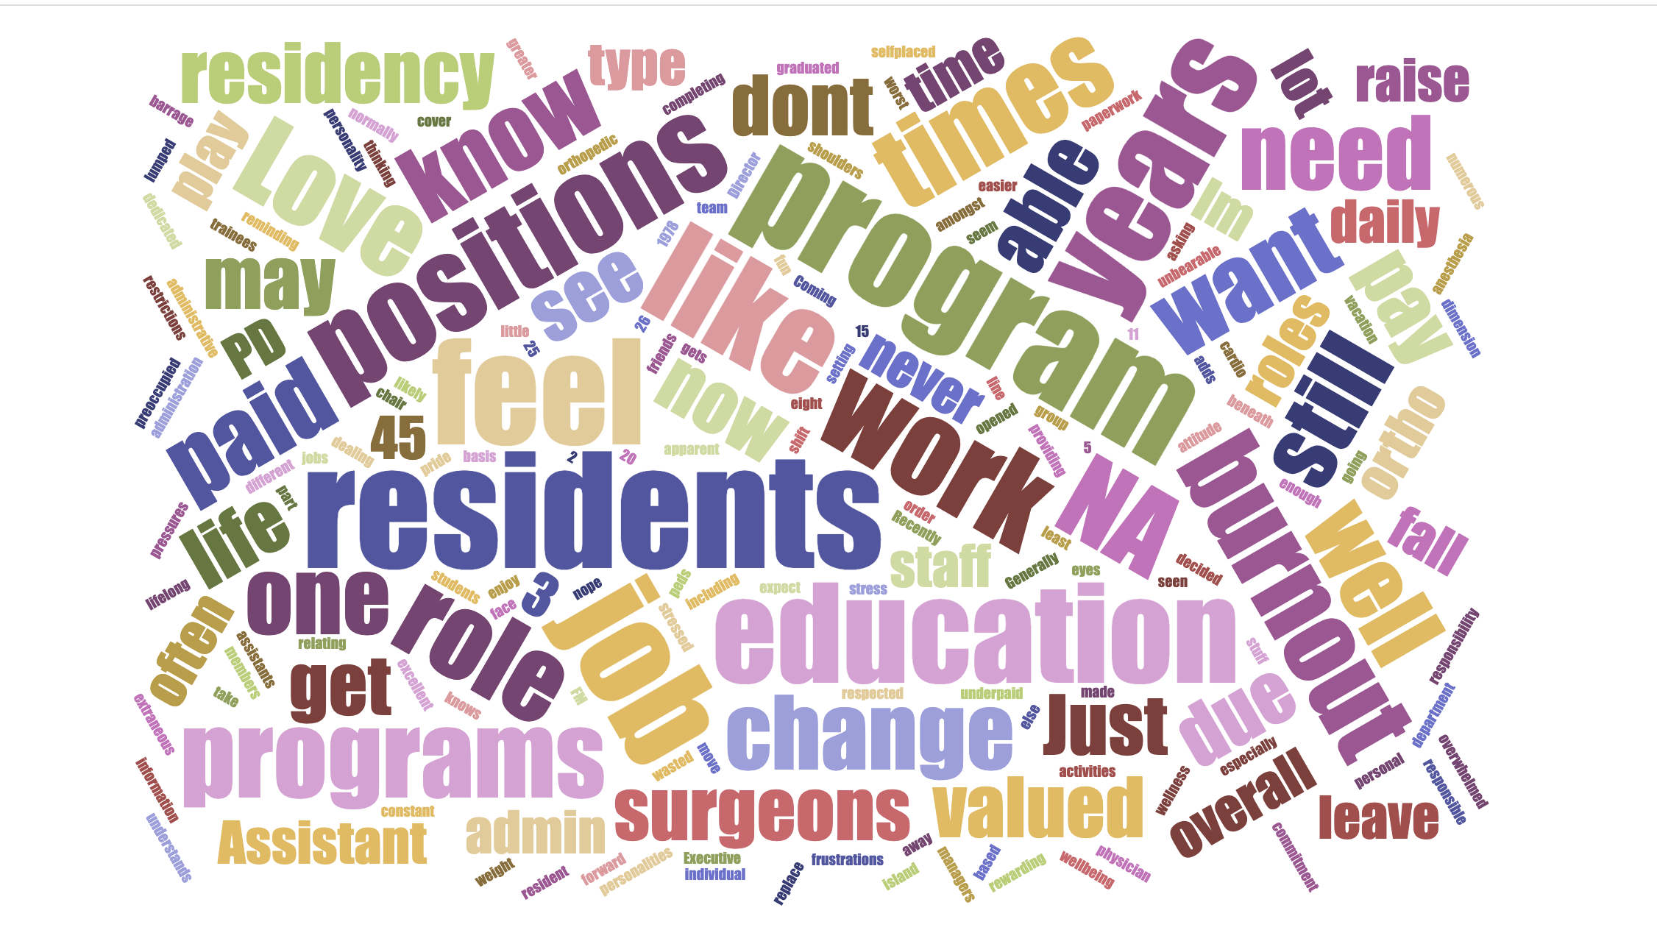

Slide 45
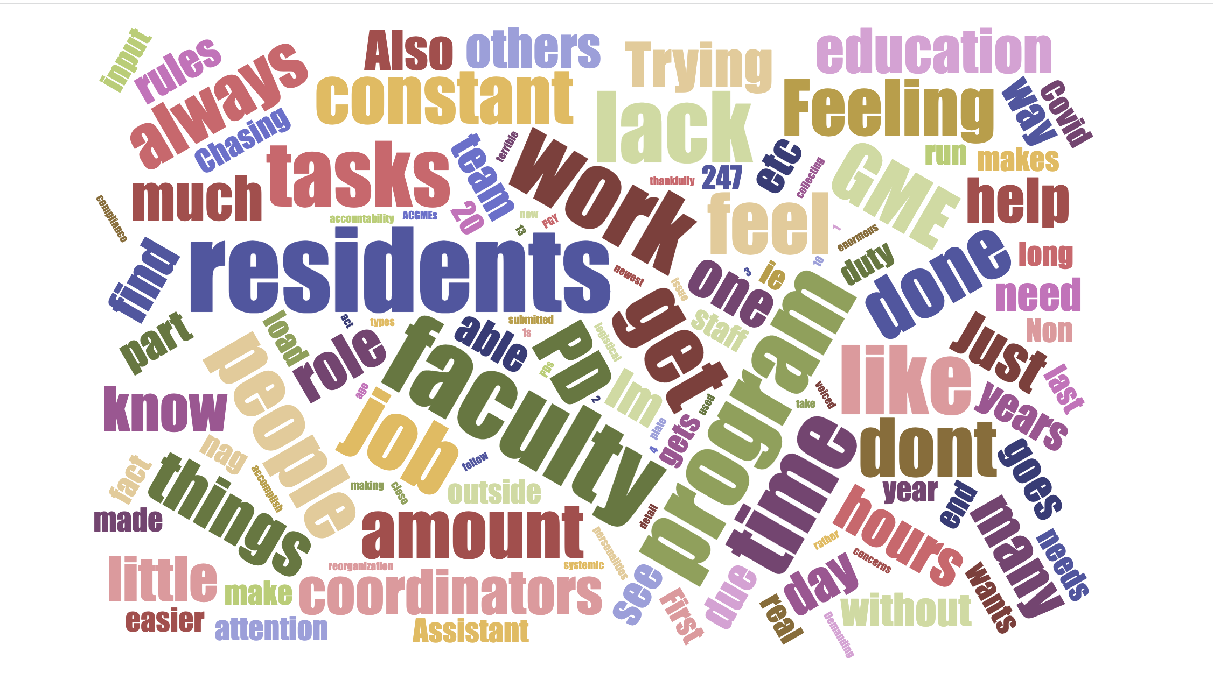

Slide 55
Years Experience vs. Exhaustion
Regression Statistics
Multiple R | 0.00219188
R Square | 4.8043E-06
Adjusted R Square | -0.0091695
Standard Error | 8.04308096
Observations | 111
ANOVA
 | df | SS | MS | F | Significance F
Regression | 1 | 0.03387725 | 0.03387725 | 0.00052368 | 0.98178466
Residual | 109 | 7051.33549 | 64.6911513
Total | 110 | 7051.36937

Slide 56
Years Experience vs. Exhaustion

Slide 58
Years Experience vs. Cynicism
Regression Statistics
Multiple R | 0.03893679
R Square | 0.00151607
Adjusted R Square | -0.0076443
Standard Error | 8.49393924
Observations | 111
ANOVA
 | df | SS | MS | F | Significance F
Regression | 1 | 11.9405398 | 11.9405398 | 0.16550292 | 0.68493756
Residual | 109 | 7864.02342 | 72.1470039
Total | 110 | 7875.96396

Slide 59
Years Experience vs. Cynicism

Slide 60
Years Experience vs. Cynicism

Slide 61
Years Experience vs. Personal Effectiveness
Regression Statistics
Multiple R | 0.12903756
R Square | 0.01665069
Adjusted R Square | 0.00762914
Standard Error | 5.42012487
Observations | 111
ANOVA
 | df | SS | MS | F | Significance F
Regression | 1 | 54.2212529 | 54.2212529 | 1.84565687 | 0.17709432
Residual | 109 | 3202.17514 | 29.3777536
Total | 110 | 3256.3964

Slide 62
Years Experience vs. Personal Effectiveness

Slide 63
You Are….

Slide 65
Practical Steps
Doctors are unlikely to change
Stand up to ACGME and groups that want to waste your time
Be engaged

Slide 66
Practical Steps
Doctors are unlikely to change
Stand up to ACGME and groups that want to waste your time
Be engaged

Slide 69
Practical Steps
Doctors are unlikely to change
Stand up to ACGME and groups that want to waste your time
Be engaged

Slide 72
Practical Steps
Doctors are unlikely to change
Stand up to ACGME and groups that want to waste your time
Be engaged

Slide 76
Thank you

